Slide 1
FYP (CS-4092), Progress Report
Spring ‘22, BS(CS)
“CodeClassy”

Slide 2

CodeClassy
Team Members
Saif Ul Islam - 18K 0307
Hassan Zahid - 18K 0208
Tashik Moin Sheikh - 18K 0142
Supervisor
Muhammad Rafi (muhammad.rafi@nu.edu.pk)

Slide 3
1.
INTRODUCTION
“An online collaborative platform that fits major EdTech needs”
Classroom Management System
Quiz Management System
Coding Assignments (RCE + RTC)

Slide 4
Our primary goal being to work on an EdTech product integrating several solutions together into a single platform to help and propagate collaborative learning together between the teacher/student

Slide 5
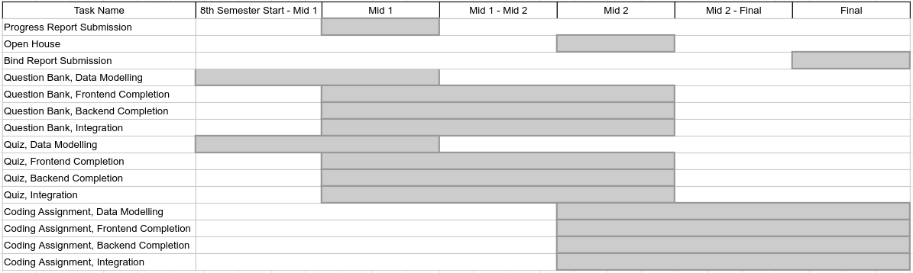
FYP II Timeline

Slide 6
Progress, Current Plans, Development
Primary goals include,
Question Bank
Quiz
Coding Assignment
Each of which is concerned with,
Data Modelling
Frontend
Backend
Integration

Slide 7
UPDATE TIMELINE
Comparing our 7th Semester progress vs 8th Semester timeline

Slide 8
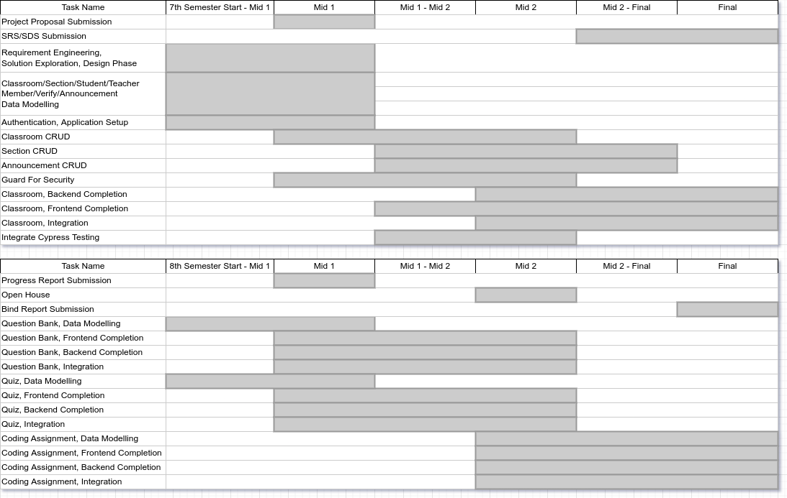

Slide 9
Expected delivery
June ‘22
Recent progress
Question Bank + Quiz Data Modelling
Progress Report
Bug Fixes
Flow Decisions related to Question Bank + Quiz
Obstacles
Data Modelling proves to be time intensive
Semester work along with this project

Slide 10
Next Steps
Finishing Data Modelling For Question Bank, Quizzes
Finishing the Data Modelling for Question Bank, Quizzes, and so integrating front-end, back-end, to overall finish Quiz Management System
Coding Assignment Discussion, Data Modelling, Integration
Finally moving onto the last module of our project, front-end prototyping and backend integration

Slide 11
Thank you! 🎉 🎊 🥳
Progress continues despite obstacles
Core idea continues
Questions, if any

